Slide 1
CodePath
Week 6
CS 4760 F18
Christopher Raley

Slide 2
Codepath Homework
Lab report 10/14 @ 11:59 PM
Submitted on Collab
This includes Security Shepherd
User Authentication (0 - 3)
Password Hashing (0 - 3)

Slide 3
User Authentication
Username Enumeration
Credential Theft
Privilege Escalation
Brute Force Attack (review)
Dictionary Attack (review)
Topics
Week 6
Readings on course website
Mostly review for attacks

Slide 4

User Authentication
Recall topics such as
Password hashes
Salts
Multi-factor authentication
Key space for brute-force
etc

Slide 5
User Enumeration
User Enumeration: Process of enumerating all possible usernames in an application, server, etc.
Strategy: Enter random usernames to see what error-handling message you get
Dumpable Username Enumeration: Manipulation that allows a full/partial list of valid users
Often a result of SQL Injections (as you hopefully saw)

Slide 6
Login Page
Username: “john”
“User john is not found”

Slide 7
Login Page
Username: “john”
“User john is not found”
“User not found/invalid”

Slide 8
Credential Theft
Credential Theft: Action of retrieving a user’s login credentials
Three techniques
Phishing
Key-logging
Database theft
Usually part of other attacks as well
IDOR
SQLi

Slide 9
Privilege Escalation
Privilege Escalation: Exploiting a vulnerability such that it allows an attacker to gain access to resources which are normally restricted
Strategy: Gain access to root or admin
Go from normal user to a root user
Can result due to pivoting
Using a ‘plant’ or ‘foothold’ to move around inside a network
Why: For attackers to get around the “Principle of Least Privilege”

Slide 10
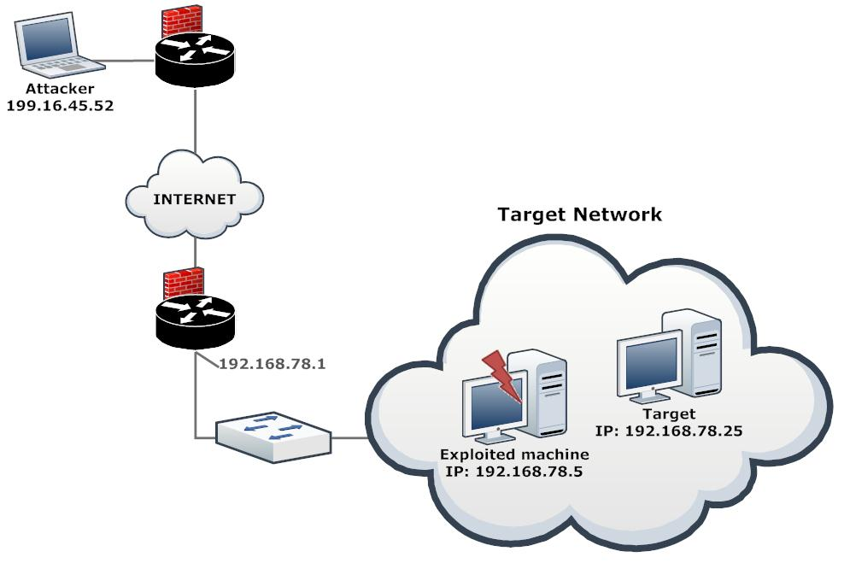

Slide 11
Recap
Which of the following should result from an incorrect username and/or password?
Invalid username and incorrect password
Invalid user
Invalid username and/or password
Incorrect password

Slide 12
Lab Report
Need to do all required Security Shepherd challenges
You can find them under the “Lab” tab on the course page
You need to include step-by-step instructions with screenshots on how you did them
Similar to extra credit for CTF’s

Slide 13
Lab Report
Additionally, you need to make a walkthrough on how you got Hashcat installed/working on your machine
Include screenshots
Make sure to submit a PDF in the format as described in the write-up

Slide 14

Hashcat
Hashcat: “world’s most fastest and most advanced password recovery utility…”
You will need this tool for the lab report
Check these out
https://github.com/hashcat/hashcat
https://hashcat.net/hashcat/

Slide 15
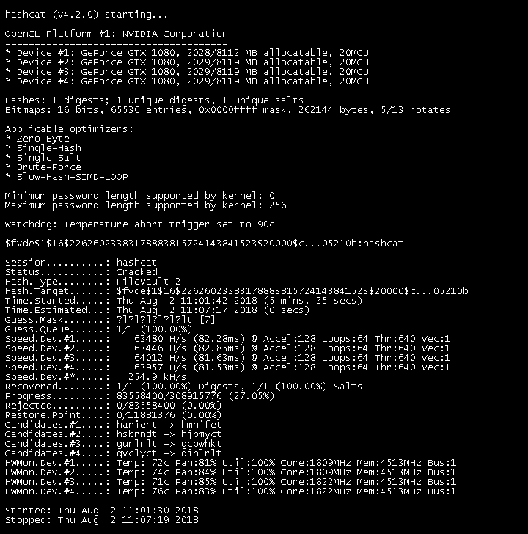

Slide 16
Security Shepherd Tips
To confirm admin accounts…
Admin, administrator, root, superuser, manager, etc.
Inspect the element
Use Burp
Brute-force some user id’s

Slide 17
Office Hours
Monday / Thursday / Sunday : 5 - 7 PM @ Rice 226

